Slide 1
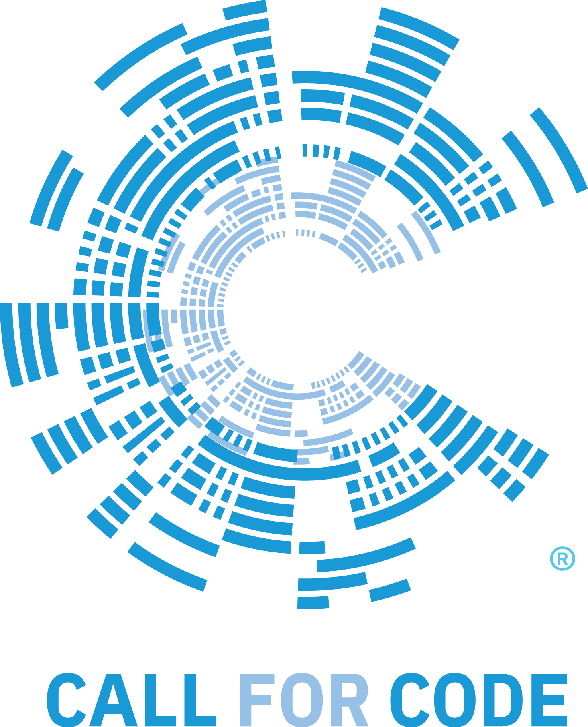
IBM Developer Way

Slide 2
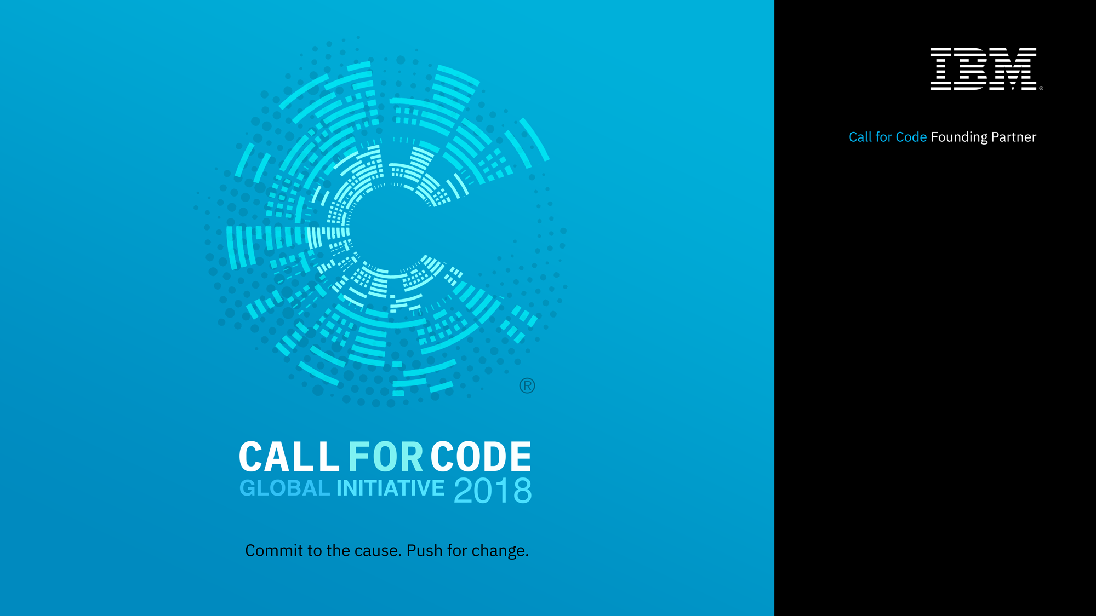

Slide 3
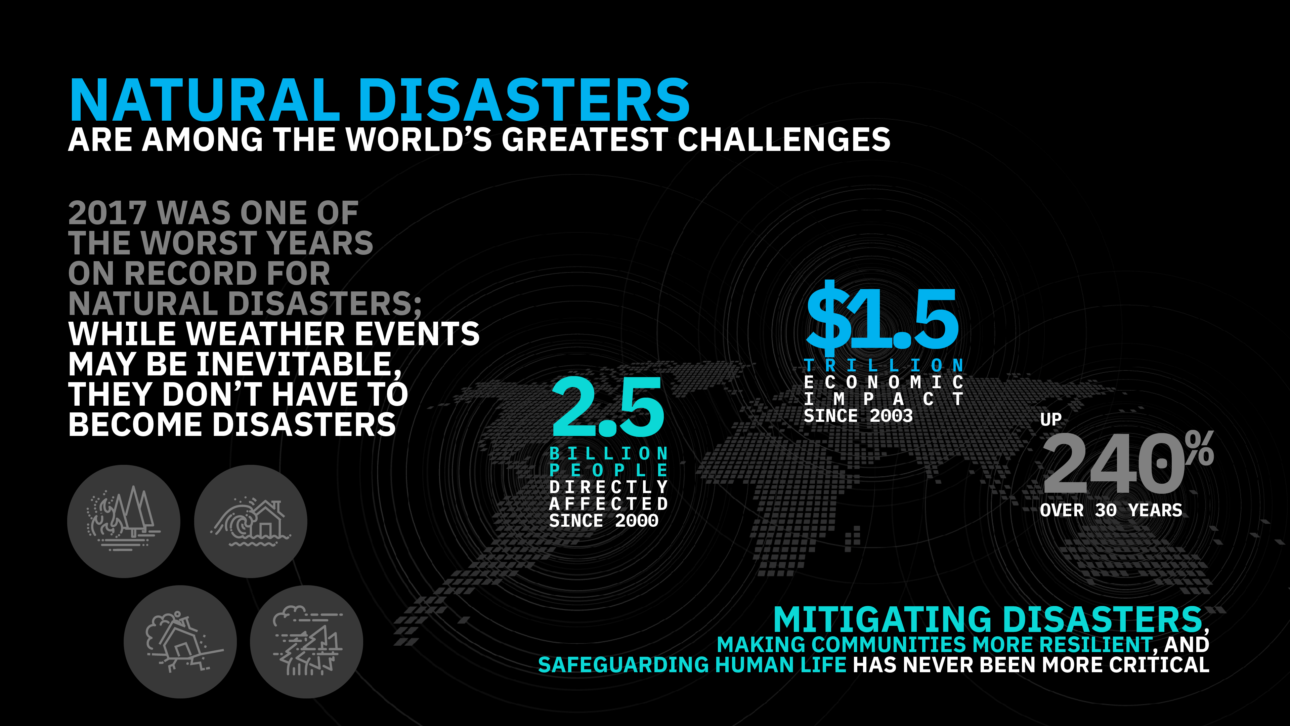
Notes:
Through our long history of working with the world’s developers, particularly in the open source community, we know their impact as the builders of modern business. We also know, through our long history of leading the industry to leverage technology for societal good, that developers can have a similar impact as the builders of a better society – both in ethical considerations for how technology is built and more directly in the use of their skills to address some of the most pressing problems of our modern world.

Slide 4
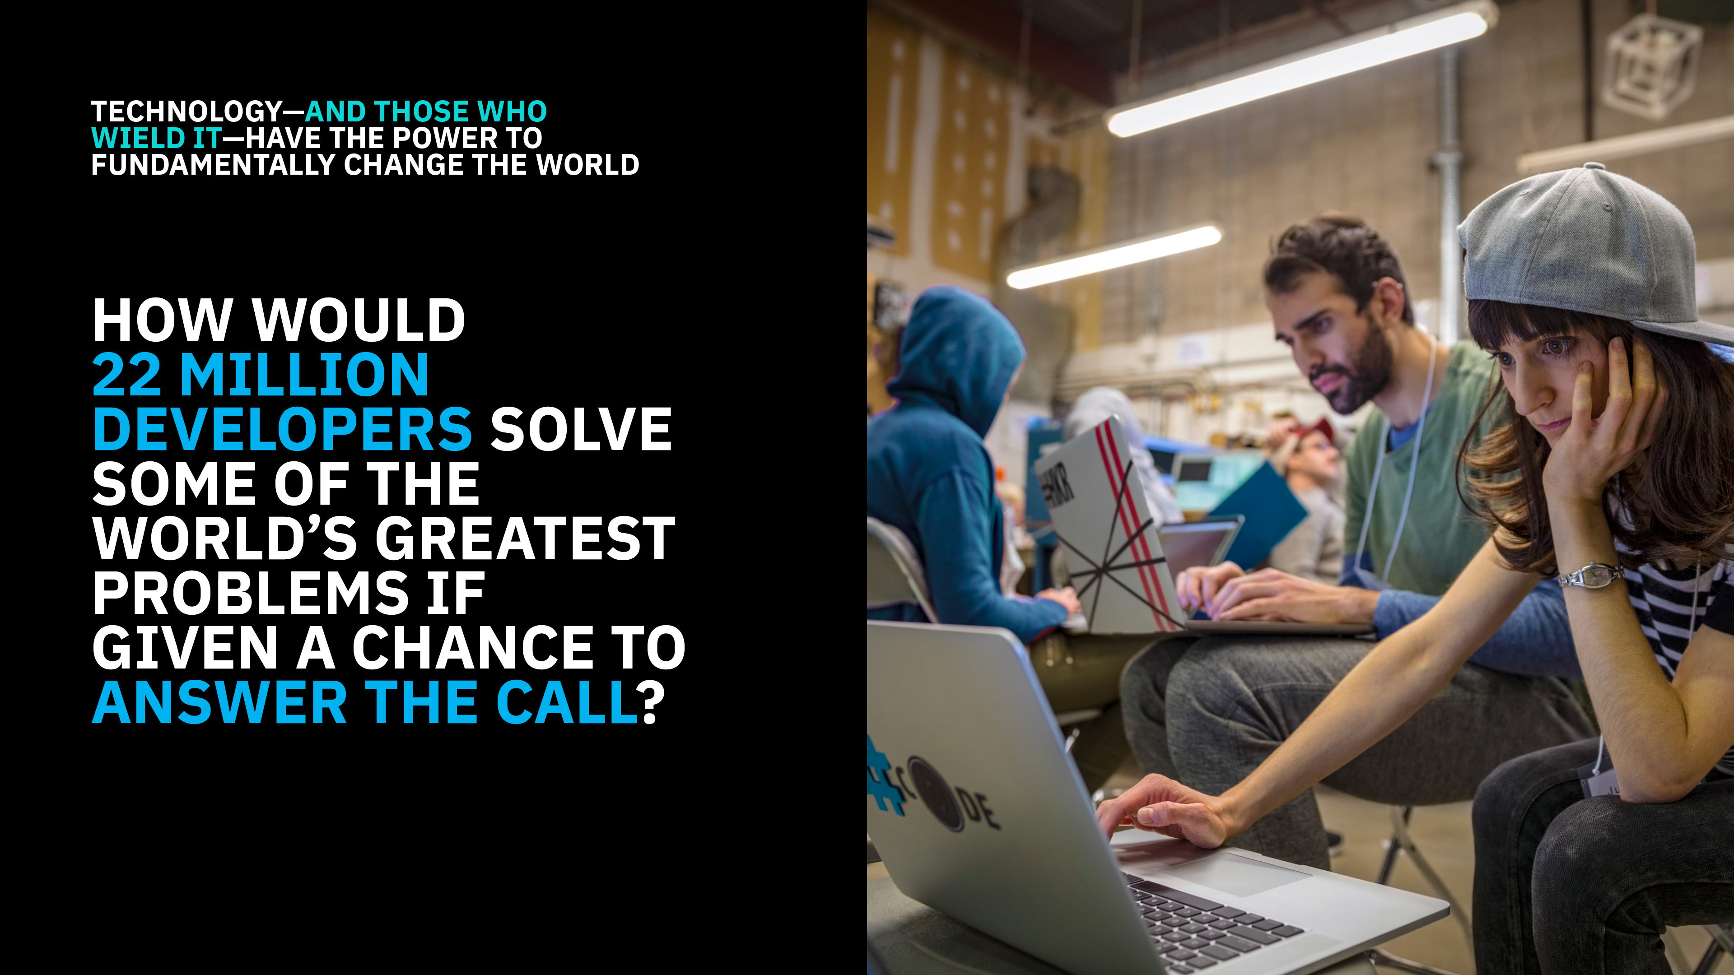

Slide 5

Call for Code inspires developers to solve pressing global problems with sustainable software solutions, delivering on their vast potential to do good.
Bringing together NGOs, academic institutions, enterprises, and startup developers to compete build effective disaster mitigation solutions, with a focus on health and well-being.
International Federation of Red Cross/Red Crescent, The American Red Cross, and the United Nations Office of Human Rights combine for the Call for Code Award to elevate the profile of developers.
Award winners will receive long-term support through open source foundations, financial prizes, the opportunity to present their solution to leading VCs, and will deploy their solution through IBM’s Corporate Service Corps.
Developers will jump-start their project with dedicated IBM Code Patterns, combined with optional enterprise technology to build projects over the course of three months.
Judged by the world’s most renowned technologists, the grand prize will be presented in October at an Award Event.
developer.ibm.com/callforcode

Slide 6
Build resilient financial networks to
execute secure transactions quickly
Code Patterns
Deploy an asset-transfer app using blockchain
Create your first blockchain network
Create and execute blockchain smart contracts
Automate business processes via blockchain
Track financial donations with blockchain
Plus tech talks, blogs, recommended services
Includes inspirational NGO use cases
Translate voice and written communications
on the fly to improve information sharing
Code Patterns
Mobile application translate handwritten Korean
Analyze Twitter for sentiment and content
Create a seamless communications channel for those who speak different languages
Extract and visualize enriched data
Plus tech talks, blogs, recommended services
Includes inspirational NGO use cases
Understand, analyze, and predict healthcare
and nutrition needs to improve basic services
Code Patterns
Classify ICD-10 data with Watson
Mobile health app that uses machine learning
Deploy a scoring model to predict heart rate failure
Create visualizations to understand food insecurity
Analyze open medical datasets to gain insights
Plus tech talks, blogs, recommended services
Includes inspirational NGO use cases
Improve logistics based on traffic and weather
activity to reduce number of people affected
Code Patterns
Build a mobile chatbot for recommendations, reservations, and event planning
Correlate flight and weather data in an augmented reality mobile app
Create charts, graphs, maps using city datasets
Plus tech talks, blogs, recommended services
Includes inspirational NGO use cases
Analyze device sensor data to take corrective
or preventative action automatically
Code Patterns
Analyze industrial equipment on sight for defects
Detect voltage anomalies in household IoT devices
Develop an IoT asset tracking app using Blockchain
Plus tech talks, blogs, recommended services
Includes inspirational NGO use cases
Use visual recognition to process claims
quickly or identify immediate need for aid
Code Patterns
Apply cognitive to classify and tag mobile images Build a web-based blockchain insurance app
Locate and count items in an image with
Classify vehicle damage images
Analyze an image and send a status alert
Plus tech talks, blogs, recommended services
Includes inspirational NGO use cases

Slide 7
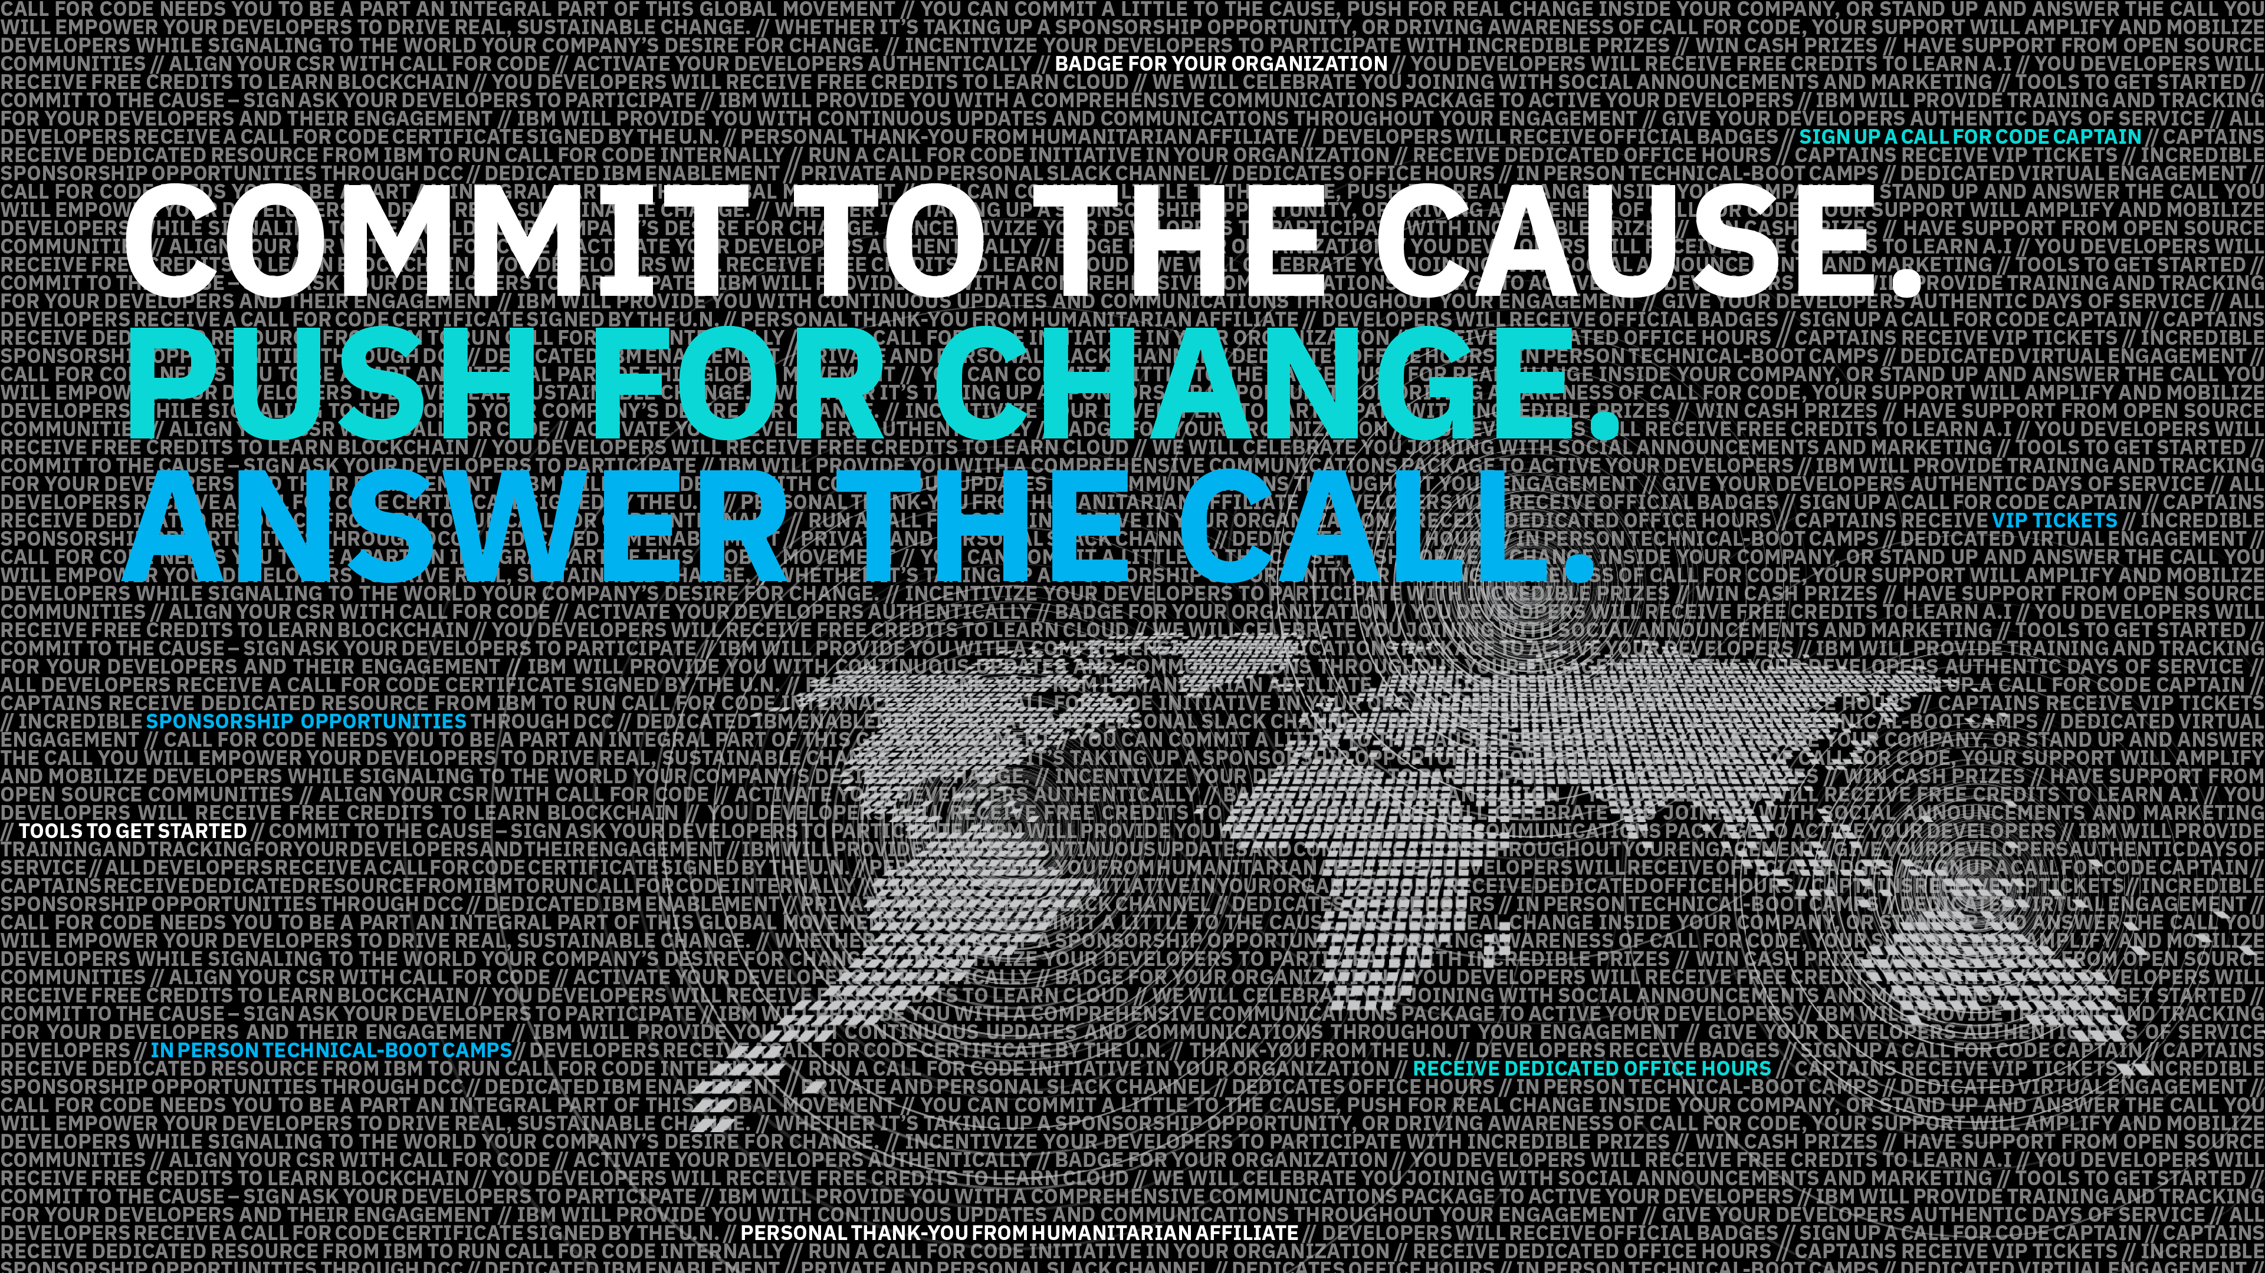

Slide 8

SHIFTS
in technology
_start
func1()
class
http://
have shaped
the market landscape
Big Business
All Business
Corporations
Individuals
Weeks
Seconds
8
Notes:
IBM helps CIOs present a bold and challenging vision for the future, but building that future in incremental steps that build on one another.

Slide 9

In the past, we used design patterns to address the shifts…
Gang of Four
Design Patterns
Creational
Structural
Behavioral
… today we need more
9
Notes:
Design patterns provide solutions to common software design problems.

Slide 10


Seismic Technology Shift
Four separate forces are occurring today
Business Models that leverage all four shifts effectively will be at a competitive advantage
10

Slide 11



The IBM Developer Way: The new age computing pattern
Code
Content
Community
The three building blocks of our Developer First Framework
11

Slide 12
The IBM Developer First Framework
IBM Code Community
IBM Coder Community
IBM Developer Advocates
IBM Development Labs
IBM Code Content
How-to
Tech Talks
Blogs
Industry Patterns
BOT Asset Exchange
Other Asset Exchanges
Open Source
Developer First Method & Products
IBM Code Patterns
Composite Pattern 2
2
2
2
1
N
1
N
1
N
Composite Pattern 1
Composite Pattern N
Developer Pattern 1
Developer Pattern 2
Developer Pattern N
IBM Code Infrastructure & Technology Exchange

Slide 13
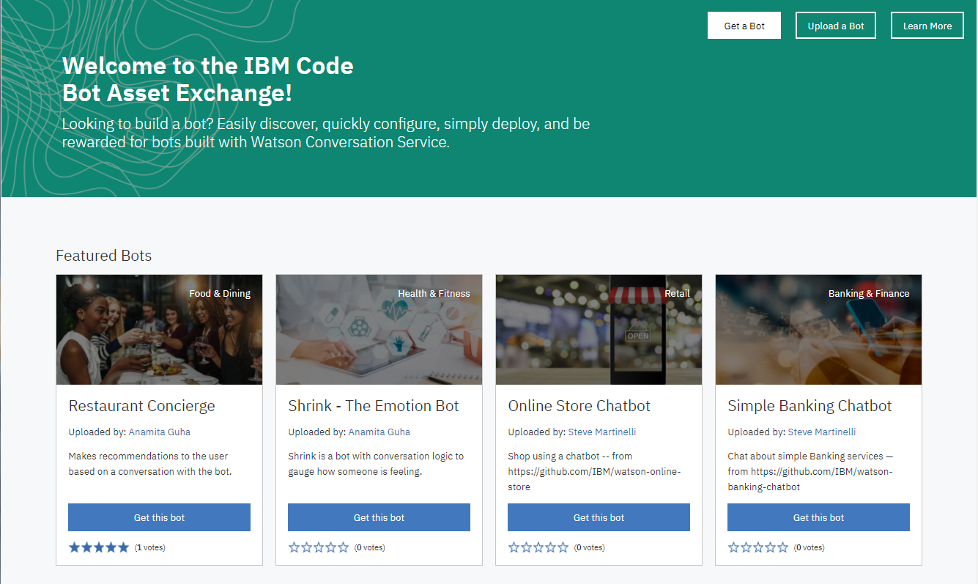

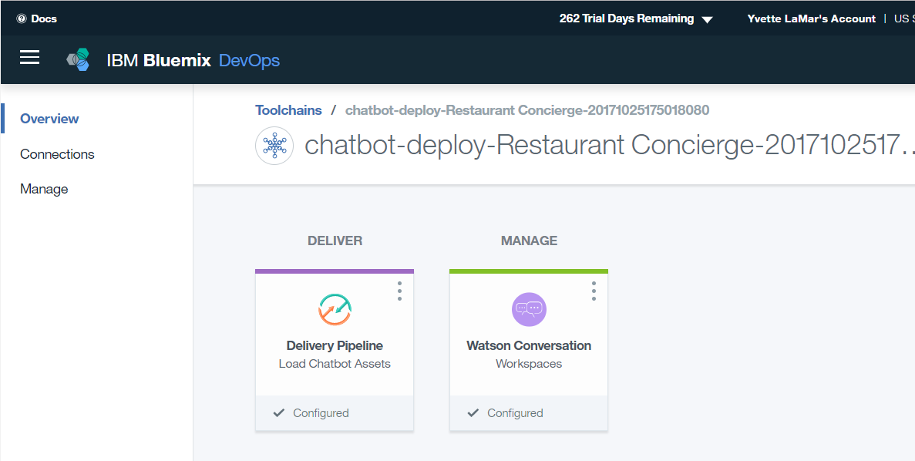
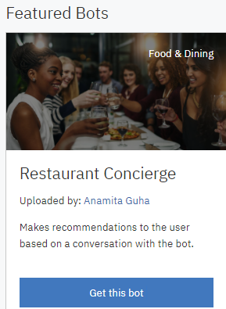
Bot Exchange
Code
Bot Asset Exchange
Easily discover, quickly configure, simply deploy, and be rewarded for bots built with Watson Conversation Service.
developer.ibm.com/code/exchanges/bots
13

Slide 14
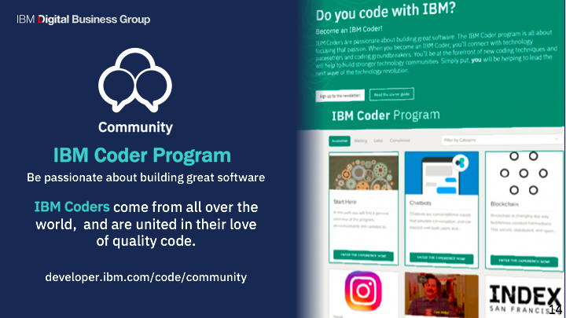

Slide 15
Thank you
Happy Coding!!!

